Slide 1
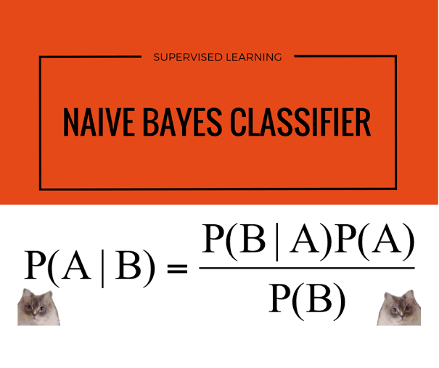
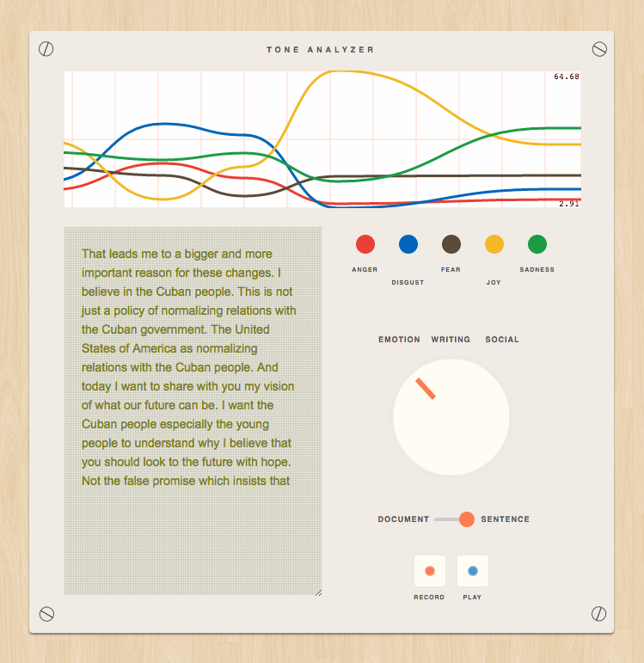

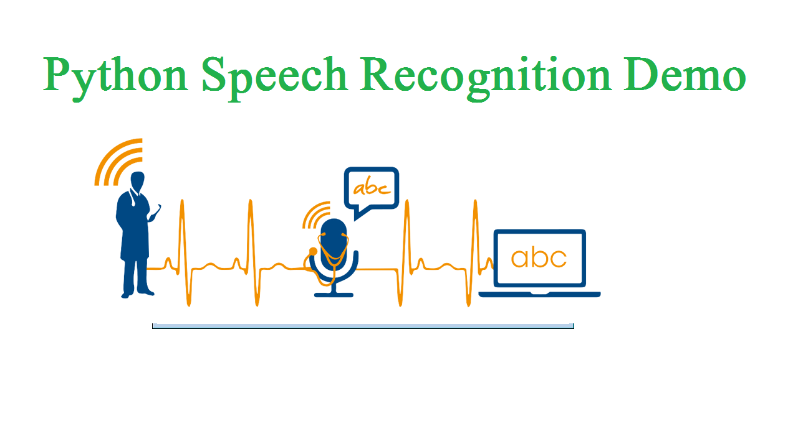
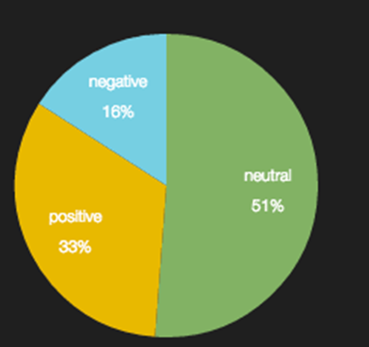
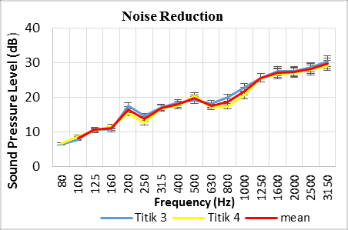
SENTIMENTAL ANALYSIS USING AUDIO(NLP)
INTRODUCTION
METHOD FOR TEXT ANALYSIS
eizaton
Sentimental analysis understands human emotions.
This uses the natural language processing to process voice data.
The emotions can be determined by getting the input voice from the customers and the and determine the emotions
To Improve the standard in a particular Area
To develop product quality and sales.
The input will be the Audio data from the Telephone conversations.
Background.
After that text Pre-processing will be done followed by algorithm is used for the classification purpose..
TOKENIZATION
LOWERCASING
NAÏVE BAYES
Tokenization
stemming stopwords removal , Lemmization and numbers removal.
Naive Bayes
NORMALIZATION
STOP WORDS
OBJECTIVES
SPECIAL CHARACTERS
To understand human feelings and to determine their emotions whether it is positive ,negative or neutral using natural language processing(NLP).
To determine human emotions in the audio.
To analyse their feedback for improving the product standard.
To Improve the standard in a particular Area
To develop product quality and sales.
METHOD FOR TONE ANALYSIS
After recorded the audio ,The Amplitude of audio crosses the particular frequency through the pitch the Tone is Analysed.
Frequency plays a major role.
SPEECH TO TEXT TRANSCRIBING
Speech recognition system transcribes the audio to text
Input will be telephone conversation audio.
For identifying feedback of product.
HAPPY,FEAR,SAD,
DIGUST,
EXCITEMENT
RESULT AND FUTURE SCOPE
Noise Reduction
The future scope will be analyzing it with big data set.
Gender of the speaker can be identified.
Many languages can be used
The background noise will be removed for proper Analysis

